Slide 1
Streaming Probabilistic Deep Tensor Factorization
Literature review

Slide 2
Contents
1
Motivation
2
Methodology
3
Empirical study

Slide 3
1 Motivation
Multilinear decomposition methods can not capture complex, non-linear relationships in data

Slide 4
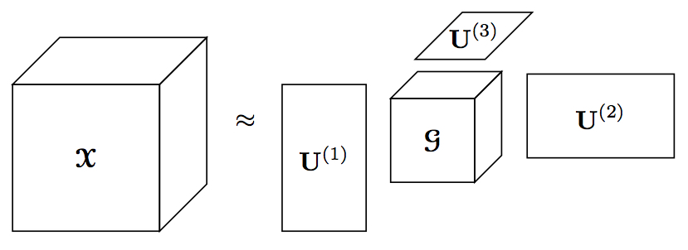
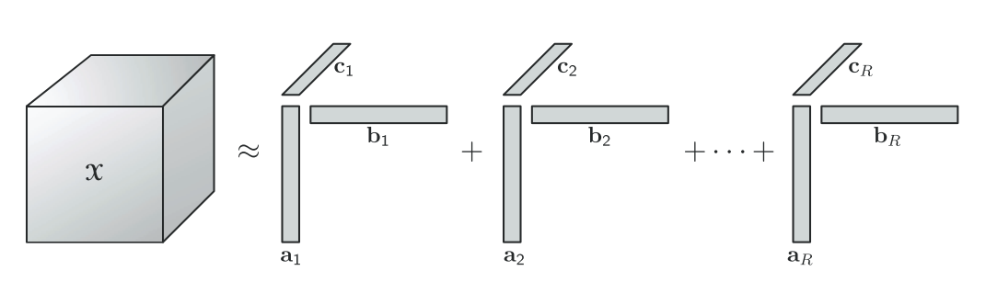

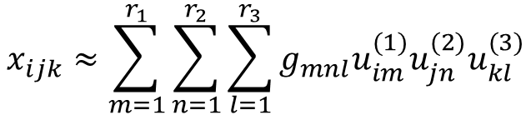
1 Motivation
Multilinear decomposition methods can not capture complex, non-linear relationships in data
$$x_{ijk}≈\sum_{m=1}^{r_{1}}{\sum_{n=1}^{r_{2}}{\sum_{l=1}^{r_{3}}{g_{mnl}u_{im}^{(1)}u_{jn}^{(2)}u_{kl}^{(3)}}}}$$
$$x_{ijk}≈\sum_{p=1}^{R}{a_{ip}b_{jp}c_{kp}}$$
Tucker decomposition
CP decomposition
Multilinear decomposition is based on prior structure assumption

Slide 5
1 Motivation
Multilinear decomposition methods can not capture complex, non-linear relationships in data
Lack of efficient NN based factorization methods for streaming data.
New coming data

Slide 6
1 Motivation
Multilinear decomposition methods can not capture complex, non-linear relationships in data
Lack of efficient NN based factorization methods for streaming data.
New coming data

Slide 7
1 Motivation
Multilinear decomposition methods can not capture complex, non-linear relationships in data
Lack of efficient NN based factorization methods for streaming data.
Remove the structure assumption: Bayesian Deep Tensor Factorization
Increasingly update posterior:
Streaming Posterior Inference
New coming data

Slide 8



2 Methodology
Bayesian Deep Tensor Factorization
$$d_{3}$$
$$d_{1}$$
$$d_{2}$$

Slide 9

2 Methodology
Bayesian Deep Tensor Factorization
1) Information in dimension are represented as latent matrix
$$d_{3}$$
$$U^{3}={[u_{1}^{3},…,{u_{i_{3}}^{3},…u}_{d_{3}}^{3}]}^{T}∈ℝ^{d_{3}×r_{3}}$$
$$d_{1}$$
$$d_{2}$$
$$U^{1}={[u_{1}^{1},…,{u_{i_{1}}^{1},…u}_{d_{1}}^{1}]}^{T}∈ℝ^{d_{1}×r_{1}}$$
$$U^{2}={[u_{1}^{2},…,{u_{i_{2}}^{2},…u}_{d_{2}}^{2}]}^{T}∈ℝ^{d_{2}×r_{2}}$$
Notes:
Each dimension corresponds to a latent matrix

Slide 10




2 Methodology
Bayesian Deep Tensor Factorization
2) Each entry is encoded by latent vectors.
$$u_{i_{3}}^{3}∈ℝ^{r_{3}}$$
$$d_{3}$$
$$U^{3}={[u_{1}^{3},…,{u_{i_{3}}^{3},…u}_{d_{3}}^{3}]}^{T}∈ℝ^{d_{3}×r_{3}}$$
$$d_{1}$$
$$i=(i_{1},i_{2},i_{3})$$
$$u_{i_{1}}^{1}∈ℝ^{r_{1}}$$
$$u_{i_{2}}^{2}∈ℝ^{r_{2}}$$
$$d_{2}$$
$$U^{1}={[u_{1}^{1},…,{u_{i_{1}}^{1},…u}_{d_{1}}^{1}]}^{T}∈ℝ^{d_{1}×r_{1}}$$
$$U^{2}={[u_{1}^{2},…,{u_{i_{2}}^{2},…u}_{d_{2}}^{2}]}^{T}∈ℝ^{d_{2}×r_{2}}$$
Notes:
Each dimension corresponds to a latent matrix

Slide 11
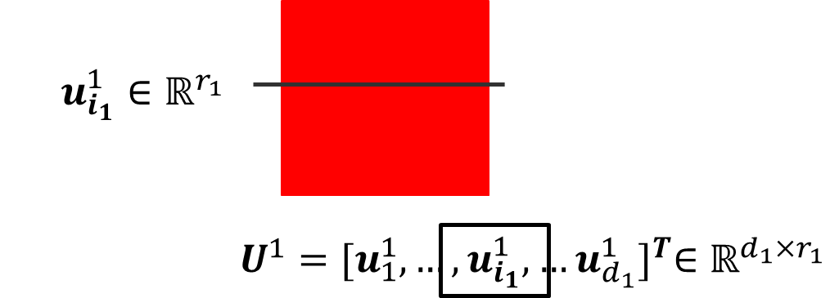
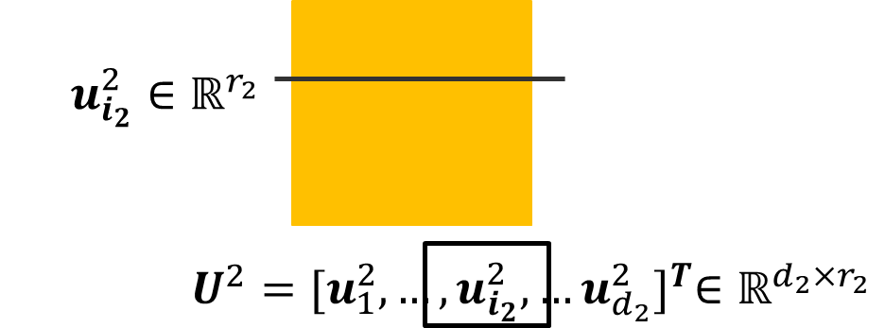
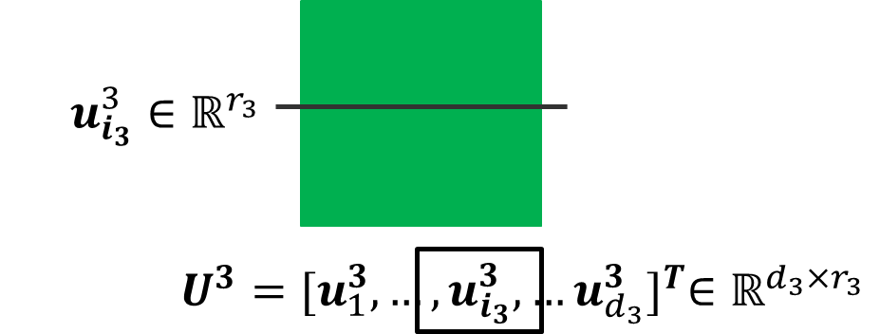

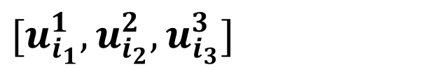



2 Methodology
Bayesian Deep Tensor Factorization
3) Assume an unknown mapping between entry and latent vectors.
$$d_{3}$$
$$[u_{i_{1}}^{1},u_{i_{2}}^{2},u_{i_{3}}^{3}]$$
$$d_{1}$$
$$i=(i_{1},i_{2},i_{3})$$
$$d_{2}$$
Notes:
Each dimension corresponds to a latent matrix

Slide 12
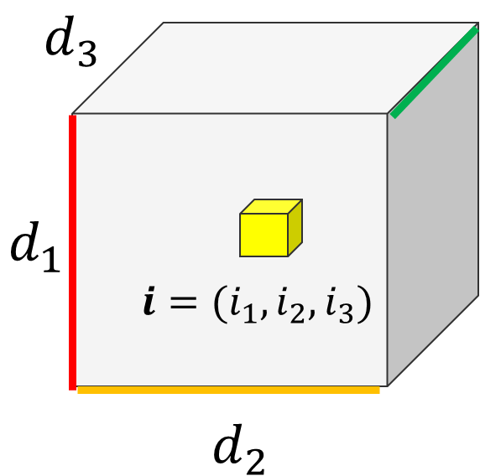




2 Methodology
Bayesian Deep Tensor Factorization
4) Use M-layer neural network to map the latent vector to output.
Gaussian distribution for continuous data
$$𝒩(y_{i}|f_{𝒲}\left(x_{i}\right),τ^{−1})$$
$$f_{𝒲}(x_{i})$$
$$x_{i}=[u_{i_{1}}^{1},u_{i_{2}}^{2},u_{i_{3}}^{3}]$$
Notes:
Each dimension corresponds to a latent matrix

Slide 13


2 Methodology
Bayesian Deep Tensor Factorization
4) Use M-layer neural network to map the latent vector to entry.
Gaussian distribution for continuous data
$$𝒩(y_{i}|f_{𝒲}\left(x_{i}\right),τ^{−1})$$
$$f_{𝒲}(x_{i})$$
$$x_{i}=[u_{i_{1}}^{1},u_{i_{2}}^{2},u_{i_{3}}^{3}]$$
Probit model for binary data
$$Φ({(2y}_{i}−1)f_{𝒲}\left(x_{i}\right))$$
$$\operatorname{Pr}\left(y_{i}=0\right)=Φ( −f_{𝒲}\left(x_{i}\right))$$
$$\operatorname{Pr}\left(y_{i}=1\right)=Φ\left( f_{𝒲}\left(x_{i}\right)\right)=1−Φ( −f_{𝒲}\left(x_{i}\right))$$
Notes:
Each dimension corresponds to a latent matrix

Slide 14
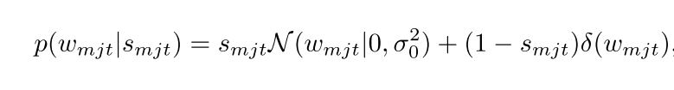
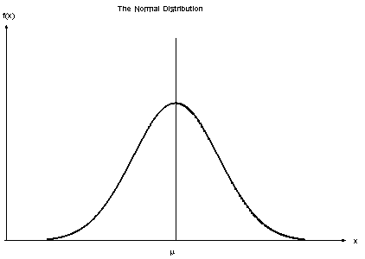
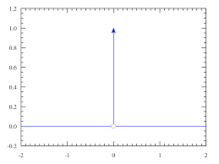
2 Methodology
Bayesian Deep Tensor Factorization
5) Add spike-and-slab prior to the weight to avoid overfitting.
Dirac-delta function
gaussian
Notes:
Each dimension corresponds to a latent matrix

Slide 15
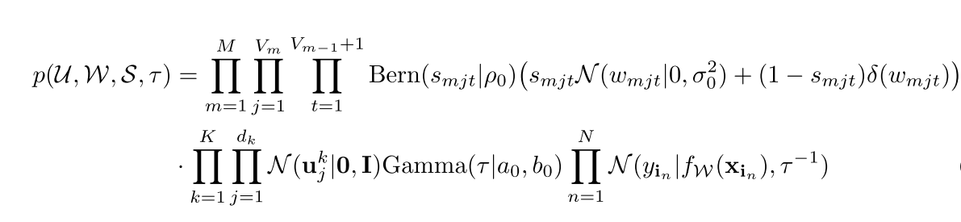
2 Methodology
Bayesian Deep Tensor Factorization
6-1) Posterior for continuous case.
Sparse prior for Neural network weights
Original posterior
Notes:
Each dimension corresponds to a latent matrix

Slide 16
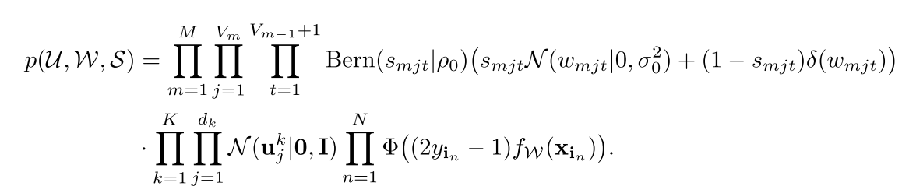
2 Methodology
Bayesian Deep Tensor Factorization
6-2) Posterior for binary case.
Sparse prior for Neural network weights
Original posterior
Notes:
Each dimension corresponds to a latent matrix

Slide 17

2 Methodology
Streaming Posterior inference
Incremental Bayes rule when new data arrives:
The new posterior is proportional
to the multiplication of old posterior and new likelihood
=Prior obtained from last training

Slide 18




2 Methodology
Streaming Posterior inference
Incremental Bayes rule when new data arrives:
Steaming Model Estimation
1) Update posterior with new data and old posterior:
Repeat when new data arrives
2) Construct variational distribution to approximate $\tilde{p}\left(θ\right)$ :

Slide 19
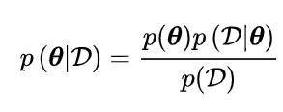
2 Methodology
Streaming Posterior inference
Incremental Bayes rule when new data arrives:
The reason for the two-step prcedure
Steaming Model Estimation
1) Update posterior with new data and old posterior:
Although we have the update equation, but update posterior accurately requires a intractable integration
Repeat when new data arrives
2) Construct variational distribution to approximate $\tilde{p}\left(θ\right)$ :

Slide 20
2 Methodology
Streaming Posterior inference
Incremental Bayes rule when new data arrives:
Steaming Model Estimation
1) Update posterior with new data and old posterior:
Repeat when new data arrives
2) Construct variational distribution to approximate $\tilde{p}\left(θ\right)$ :
Nonlinear coupling of latent vector and NN weights causes closed-form solution intractable
Can not diagnose the convergence when use SGD to optimize the target without explicit form.

Slide 21
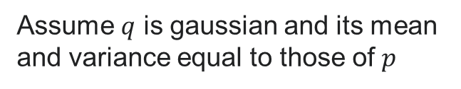
2 Methodology
Streaming Posterior inference
Online Moment Matching for Posterior Update
Approximate unknown intractable probability function $p(x$) with a tractable probability $q(x)$
Expectation propagation
Variational inference
Minimize KL(p||q)
Minimize KL(q||p)
Moment matching
Assume $q$ is gaussian and its mean and variance equal to those of $p$

Slide 22
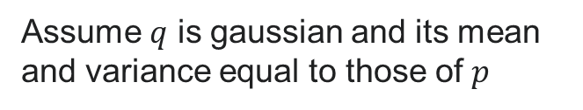
2 Methodology
Streaming Posterior inference
Online Moment Matching for Posterior Update
Approximate unknown intractable probability function $p(x$) with a tractable probability $q(x)$
Expectation propagation
Variational inference
Minimize KL(p||q)
Minimize KL(q||p)
Moment matching
The reason for using Moment Matching :
Variational inference needs SGD because there is no closed form solution due to the nonlinear coupling in the ELBO.
More efficient in online setting.
Assume $q$ is gaussian and its mean and variance equal to those of $p$
Notes:
http://citeseerx.ist.psu.edu/viewdoc/download?doi=10.1.1.88.9721&rep=rep1&type=pdf

Slide 23
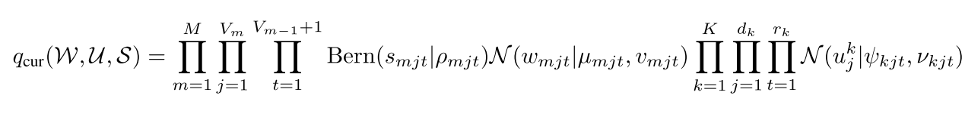

2 Methodology
Streaming Posterior inference
Online Moment Matching for Posterior Update
For each new data:
Original posterior
Update
Posterior with fully factorized exponential family distributions
Approximate posterior through moment matching using new data

Slide 24


2 Methodology
Streaming Posterior inference
Online Moment Matching for Posterior Update
For each new data:
Original posterior
Use first-order Tylor expansion to approximate the nonlinear part
Update
Posterior with fully factorized exponential family distributions
Approximate posterior through moment matching using new data

Slide 25
2 Methodology
Streaming Posterior inference
Prior approximation refinement
How to form spike-and-slab prior for each NN weight at the beginning?
Approximate the spike-and-slab prior as a distribution belongs to exponential family

Slide 26
3 Experiments
4 real world datasets
Binary tensor about bibliography relationships(author, conference, keyword)
10000x20x10000 with 0.001% nonzero entries
Binary tensor (user, anime) depict user preference
25838x4066 with 1300160 observed entries
Continuous tensor about interaction (user, action, file)
3000x150x30000 with 0.9% nonzero entries
Continuous tensor about movie rating(user, movie)
6040x3706 with 100209 observed values

Slide 27
3 Experiments
5 Baselines
POST: streaming tensor decomposition algorithm based on a probabilistic CP model
SVB-DTF: SVB based deep tensor factorization
SVB-GPTF : SVB based tensor factorization with Gaussian process to encode nonlinear
SS-GPTF: Gaussian process factorization with the recent streaming sparse GP approximations
CP-WOPT: statistic CP model

Slide 28
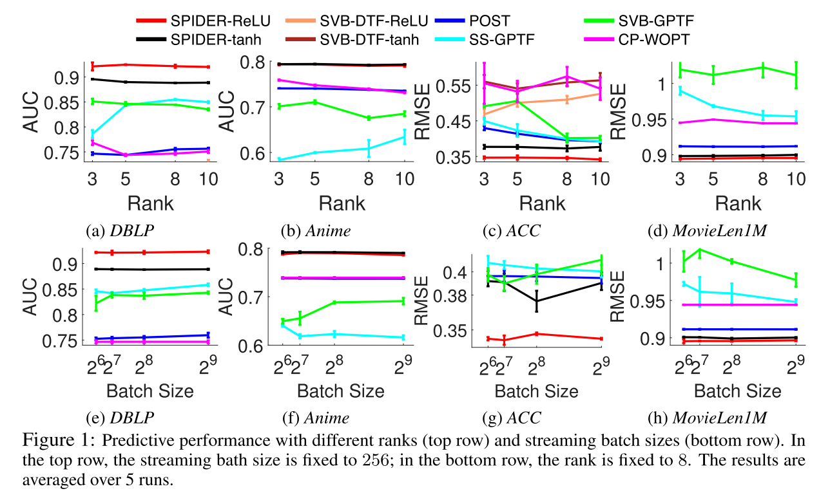
3 Experiments
Evaluate the prediction accuracy after all the (accessible) entries are processed in sequential batches
▪ Poor performance for CP based methods:
Multilinear assumption is limited to data.
▪ Poor performance for SVB based methods:
Optimize posterior based on SGD is unreliable
Notes:
Area Under the ROC Curve, receiver operating characteristic curve
AUC:The expectation that a uniformly drawn random positive is ranked before a uniformly drawn random negative

Slide 29
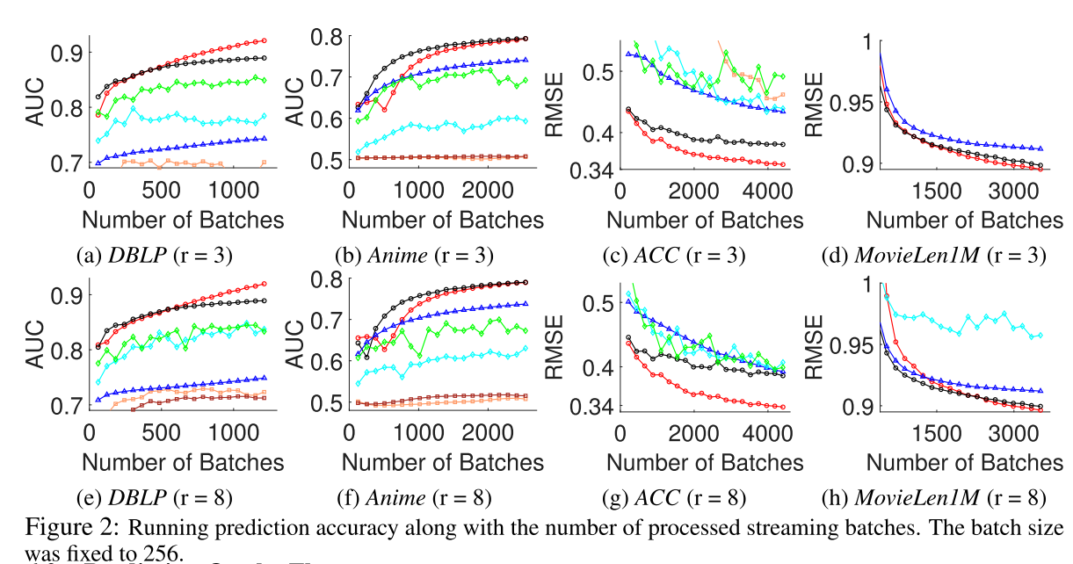
3 Experiments
Evaluate the dynamic performance. (generate a stream of batches and test after train on each batch)

Slide 30
Thank you !

Slide 31
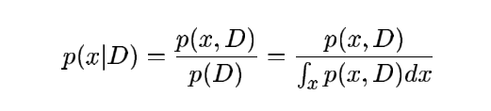
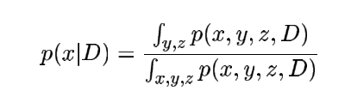
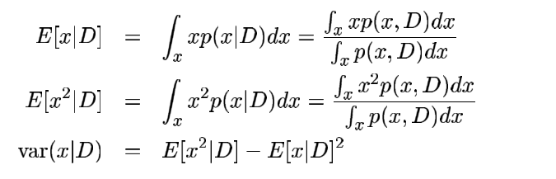
Numerical Integration is one of the critical work in Bayesian Inference

Slide 32
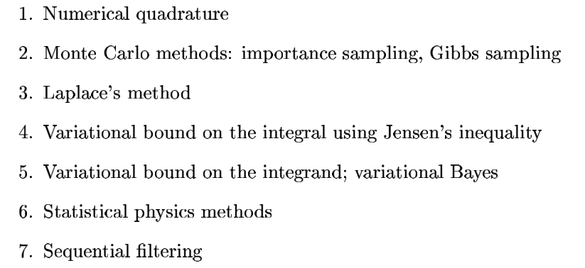
Early work on Numerical Integration
Numerical integration can be divided into deterministic(approximate the unknow intractable one with known tractable one) and non deterministic methods (sample random points to estimate integral)

Slide 33
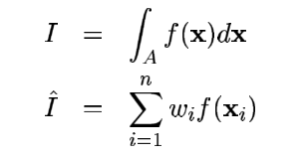


Early work on Numerical Integration
1) Numerical quadrature
2) MC
Sample uniformly
Importance sampling
Deterministic (interpolate to approximate the integrand)
Excellent when integrand is simple, especially for one dimension
Infeasible when dimension is high
Resources wastes in BI because most points are zero (sparse)
By approximate integrand with IS, the difficulties of numerical integration is replaced with the difficulties of sampling from a complex distribution. MCMC(gibbs,metropolis sampling) is introduced to fix.

Slide 34
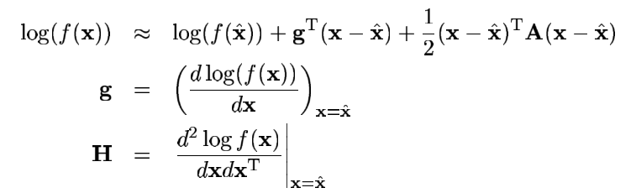
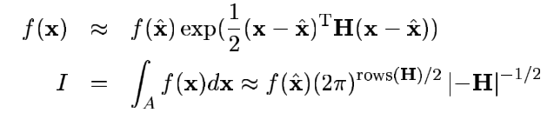
Early work on Numerical Integration
3) Laplace’s method
Taylor expansion and use the point where first-order derivate equals to 0 to simplify the calculation
H
it is limited because it is hard to consider higher derivates.

Slide 35
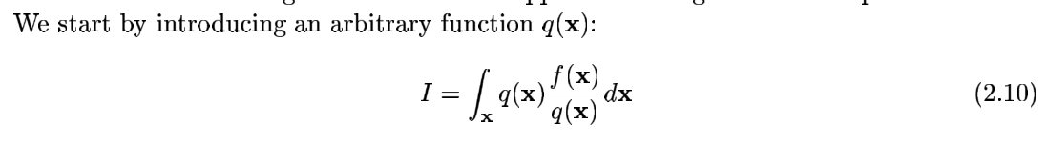
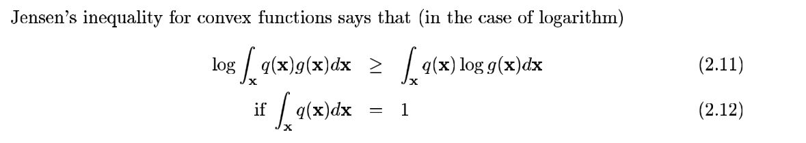
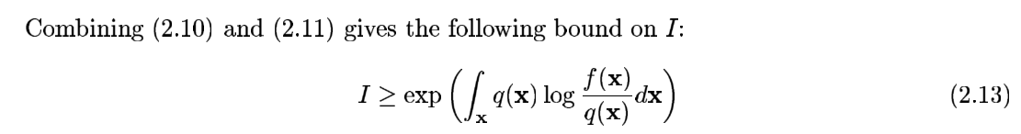
Early work on Numerical Integration
4) Variational bounding
We can instead calculate the lower bound of the original integration, Jensen’s inequality takes advantage of the fact that log(f(x)) is often easier to integrate than f(x)

Slide 36

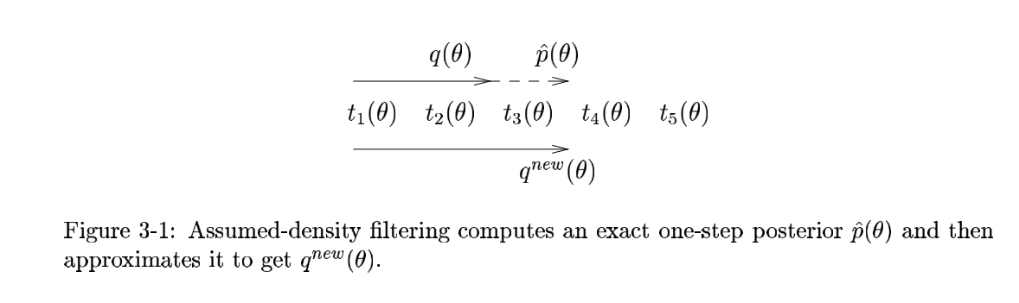

Recursive approximation techniques that try to minimize the kl divergence between true posterior and approximation
1) Assumed density filtering (online Bayesian Learning/ moment matching/ weak margination)
Application scenario: With $P(θ,D)$ where data D is observed,$θ$ is hidden, want to know $P(θ|D)$ and $P(D)$
What is the idea?
1
1
New data arrives
2
2

Slide 37





Recursive approximation techniques that try to minimize the kl divergence between true posterior and approximation
1) Assumed density filtering (online Bayesian Learning/ moment matching/ weak margination)
Application scenario: With $P(θ,D)$ where data D is observed,$θ$ is hidden, want to know $P(θ|D)$ and $P(D)$
What is the idea?
1) From Bayesian theorem
2) Factor the joint distribution into the product of simple items
3) There are many ways to factorize, one of the solution is as follows :
4) Specify a parametric distribution for approximation (exponentially family is usually the chosen one):
𝑖𝑠 𝑡ℎ𝑒 𝑎𝑝𝑝𝑟𝑜𝑥𝑖𝑚𝑎𝑡𝑖𝑜𝑛 𝑜𝑓 𝑡ℎ𝑒 𝑗𝑜𝑖𝑛𝑡 𝑑𝑖𝑠𝑡𝑟𝑖𝑏𝑢𝑡𝑖𝑜𝑛 𝑡ℎ𝑎𝑡 ℎ𝑎𝑠 𝑖𝑛𝑐𝑜𝑟𝑝𝑜𝑟𝑎𝑡𝑒𝑑 𝑐𝑢𝑟𝑟𝑒𝑛𝑡𝑙𝑦 𝑎𝑣𝑎𝑖𝑙𝑎𝑏𝑒 𝑑𝑎𝑡𝑎
5) To incorporate next data, take the exact posterior:
Repeat as new data arrives
6) The update the approximation to match the newest updated posterior by minimize the KL divergence:

Slide 38
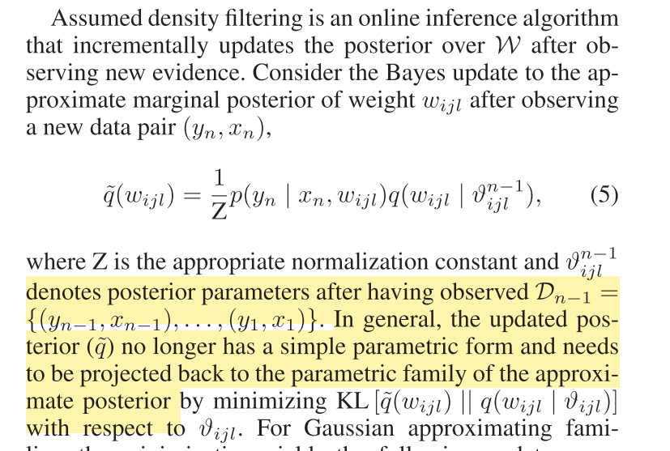
Recursive approximation techniques that try to minimize the kl divergence between true posterior and approximation
1) Assumed density filtering (online Bayesian Learning/ moment matching/ weak margination)
Application scenario: With $P(θ,D)$ where data D is observed,$θ$ is hidden, want to know $P(θ|D)$ and $P(D)$
What is the idea?
The reason for the two-step iteration
5) To incorporate next data, take the exact posterior:
Repeat as new data arrives
6) The update the approximation to match the newest updated posterior by minimize the KL divergence:

Slide 39

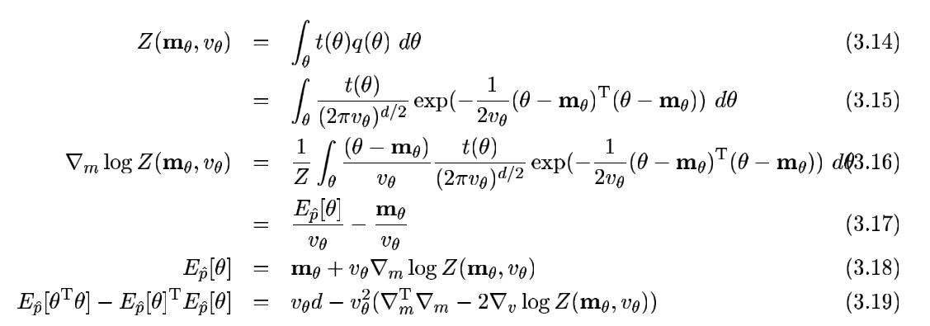
Recursive approximation techniques that try to minimize the kl divergence between true posterior and approximation
1) Assumed density filtering (online Bayesian Learning/ moment matching/ weak margination)
Application scenario: With $P(θ,D)$ where data D is observed,$θ$ is hidden, want to know $P(θ|D)$ and $P(D)$
What is the idea?
For exponential family, the minimization results in moment matching
Some tricks to calculate the moment for posterior distribution

Slide 40
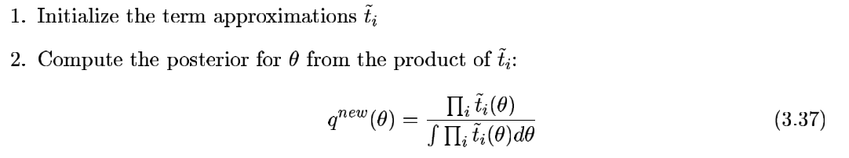
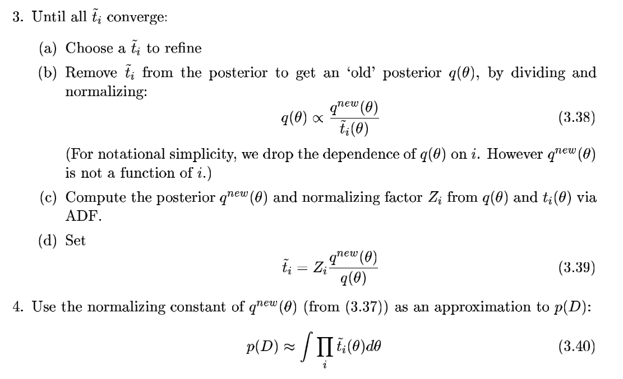
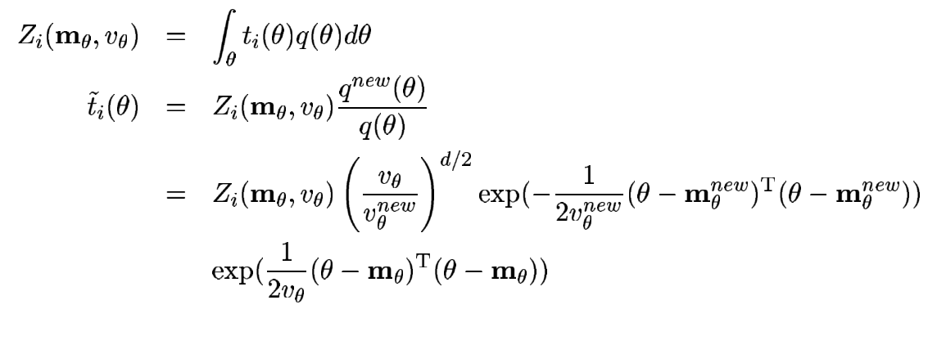
Recursive approximation techniques that try to minimize the kl divergence between true posterior and approximation
2) Expectation propagation (introduce ADF to batch situations)

Slide 41
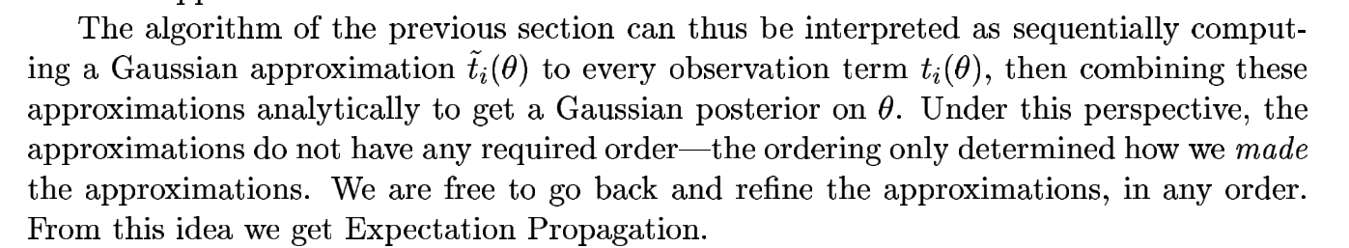
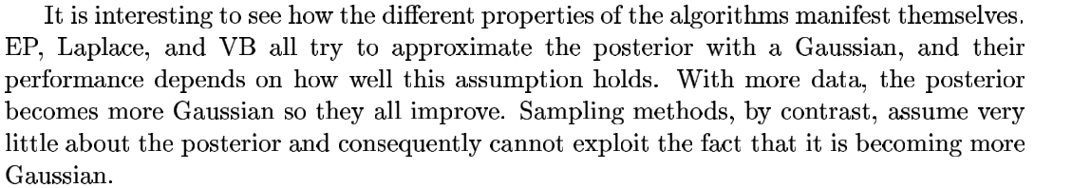
Recursive approximation techniques that try to minimize the kl divergence between true posterior and approximation
2) Expectation propagation (introduce ADF to batch situations)

